Slide 1

Bank Account Opening
Name :-S.G.D.R.Weerasingha
Reg.No.:-ASP/17/18/109

Slide 2
Description
"SMB"bank is a financial institution licensed to receive deposits and make loans. it may also provide financial services such as wealth management, currency exchange, and safe deposit boxes. The customer can select which account type can be open. The aim of this case study is to design and develop a database for the bank to maintain the records of various deposites .

Slide 3
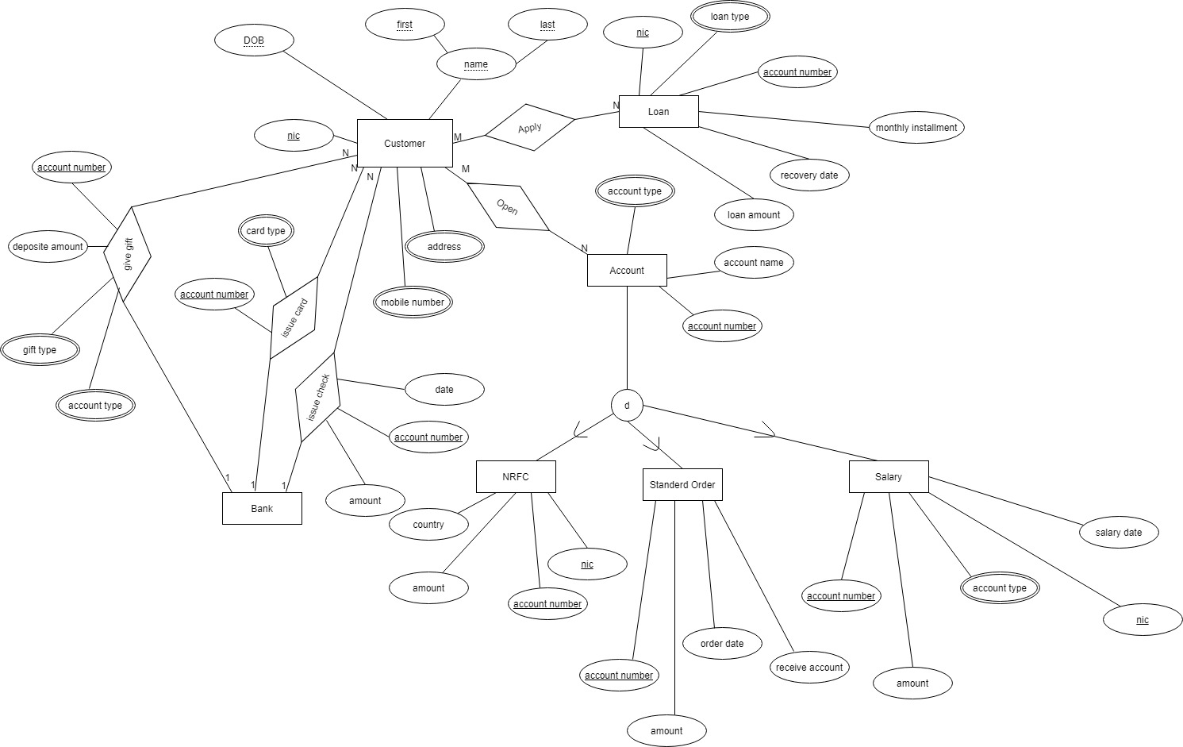
Entity Relationship Diagram

Slide 4
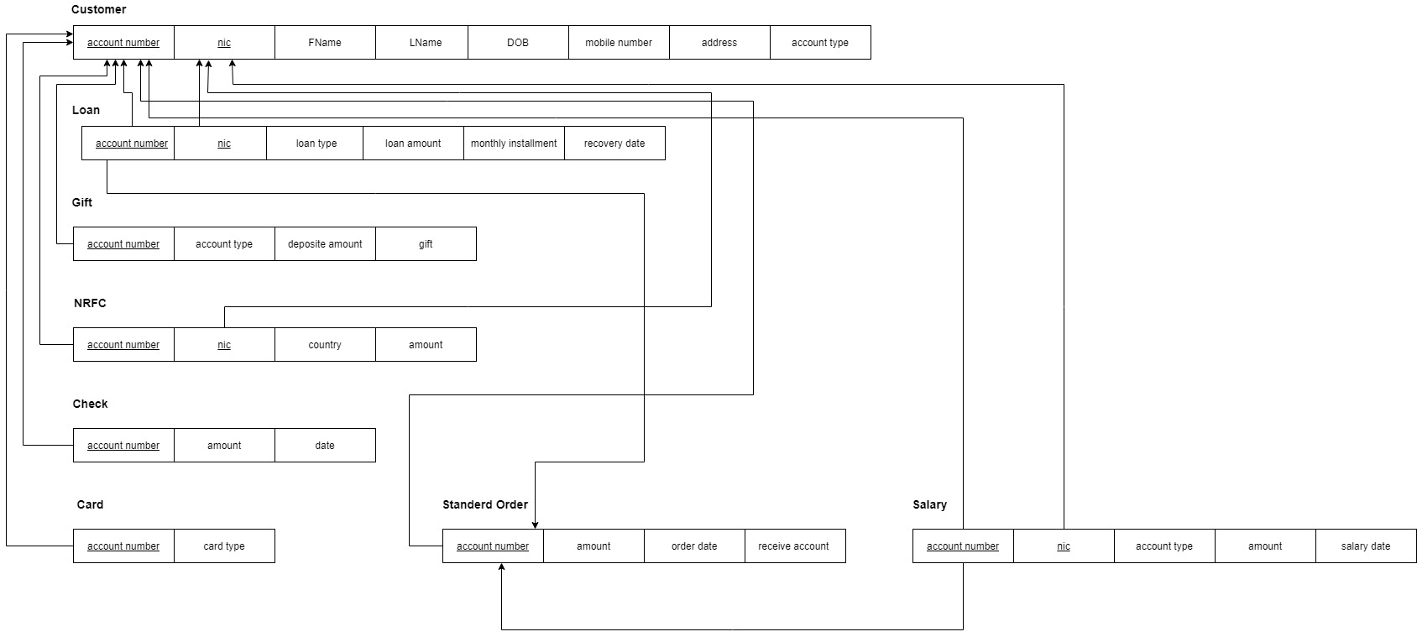
Relational Schema

Slide 5
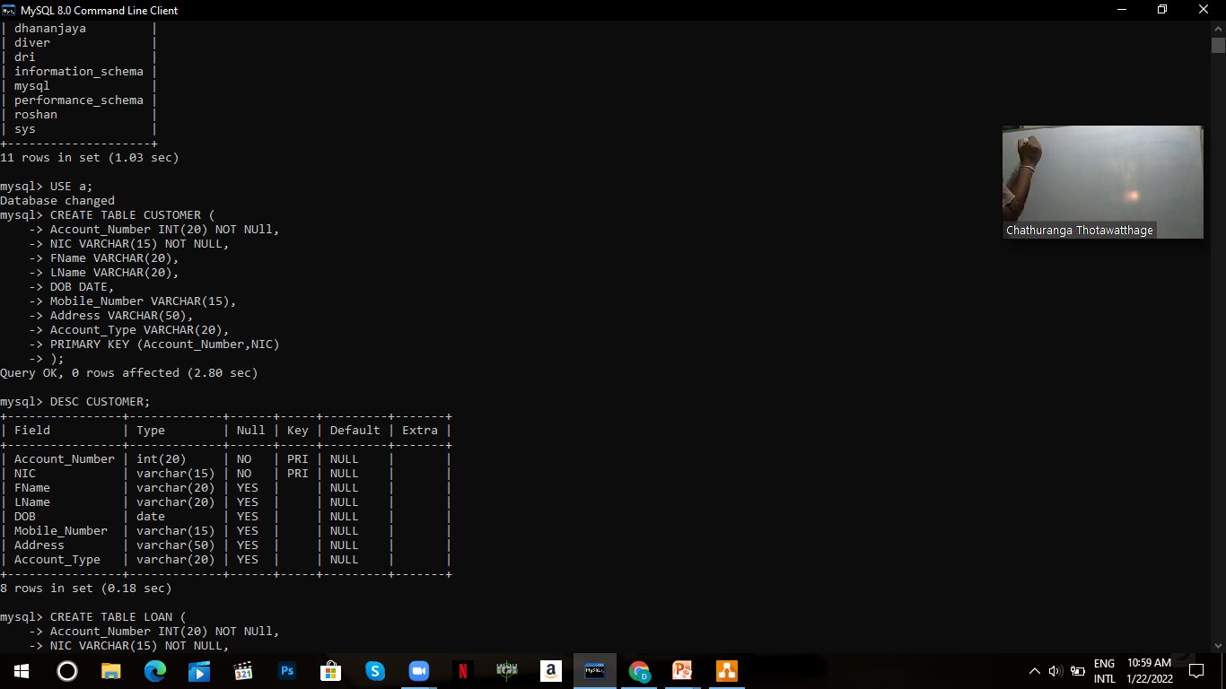
CREATE RELATION

Slide 6
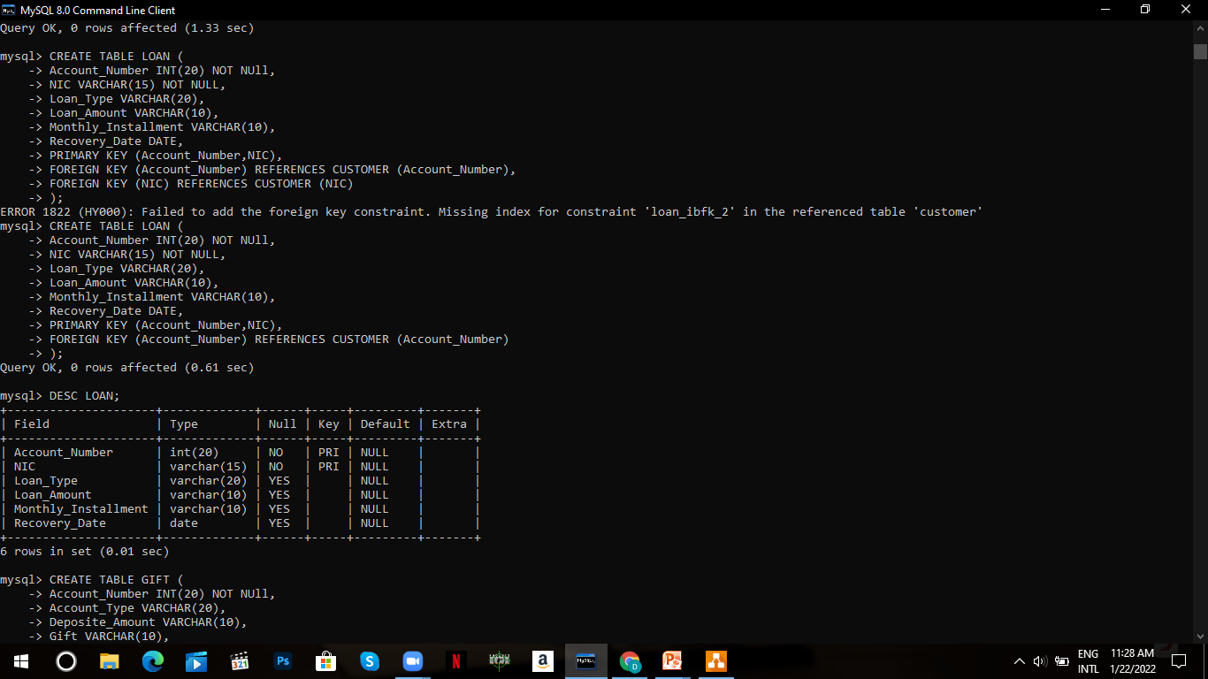
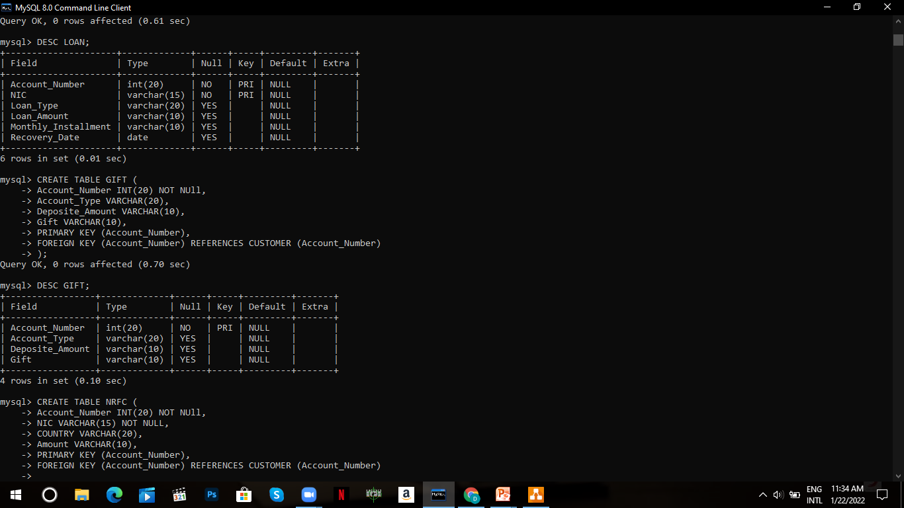

Slide 7
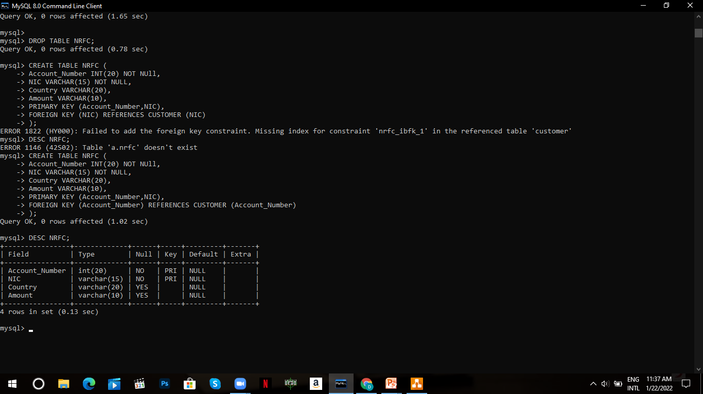
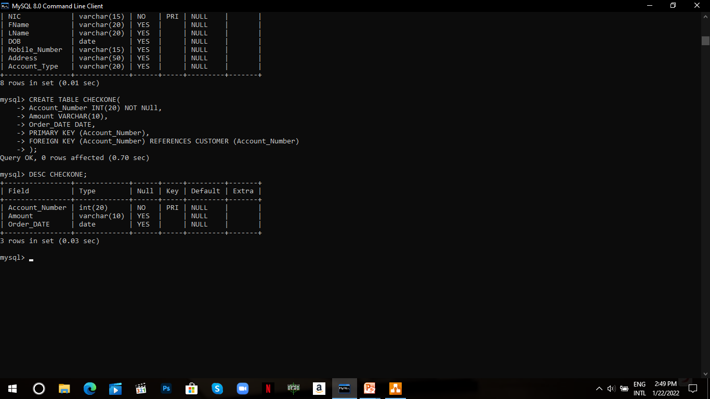

Slide 8
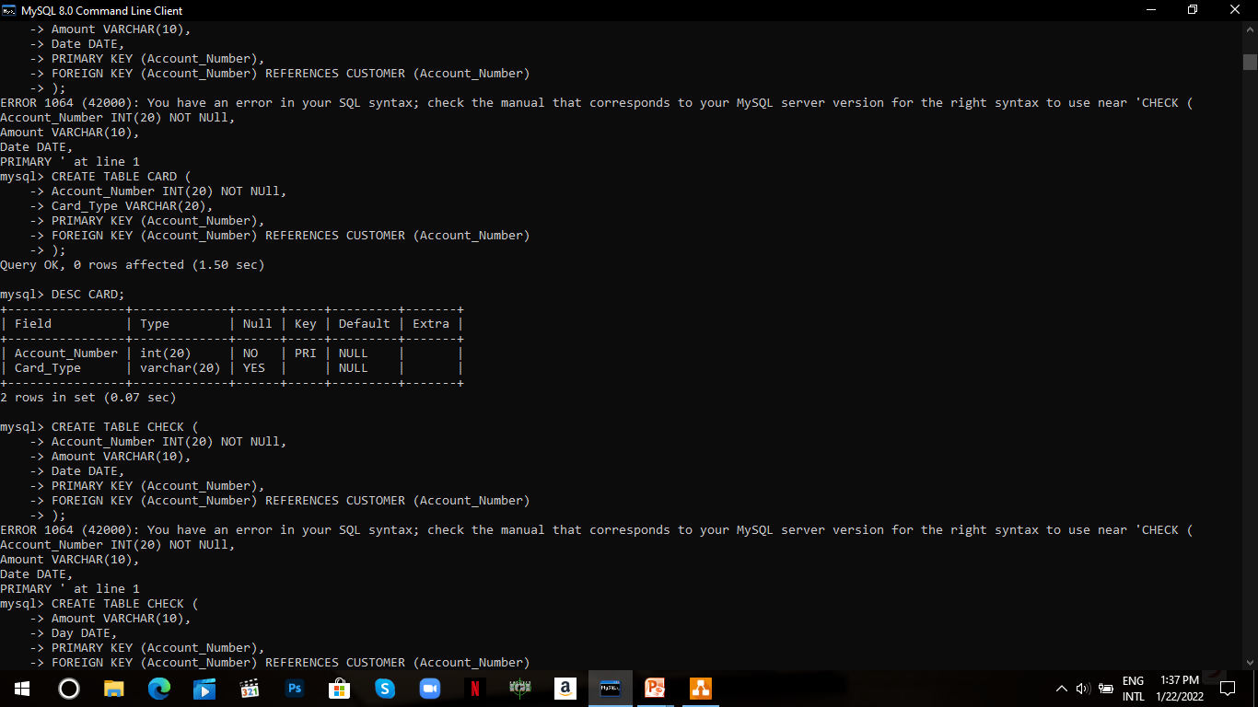
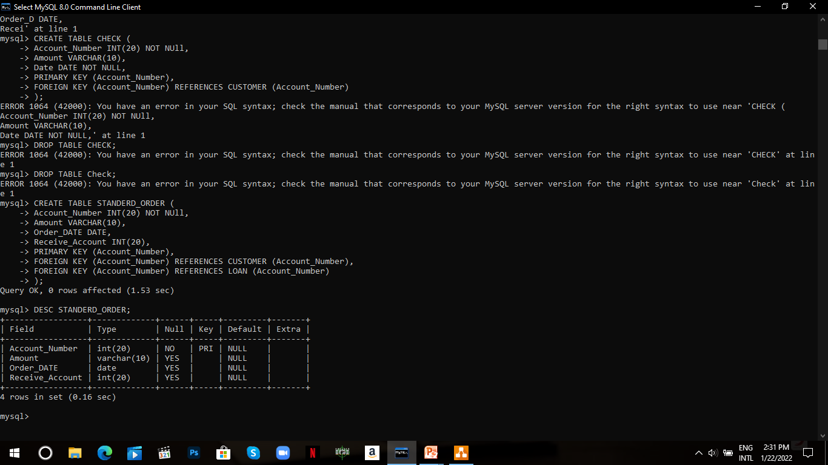

Slide 9
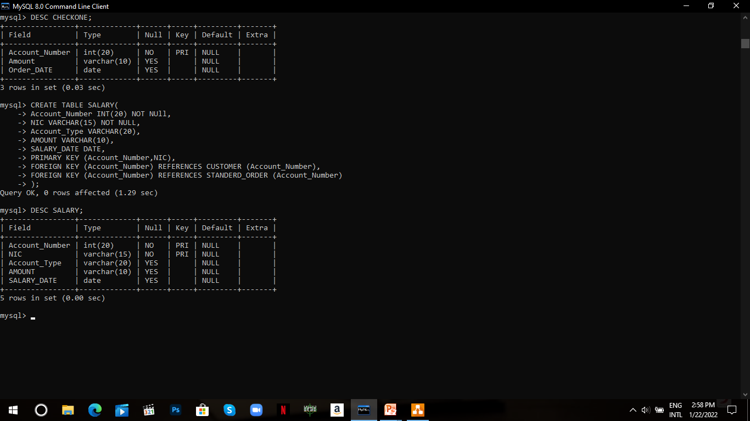

Slide 10
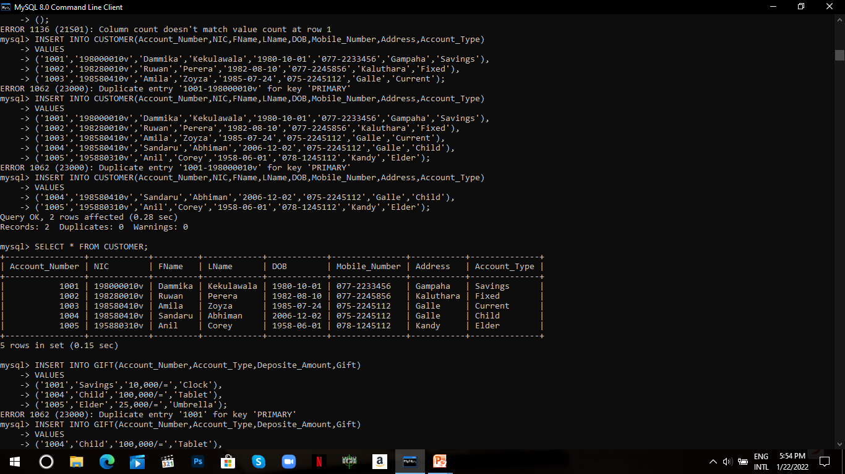
Insert Data

Slide 11
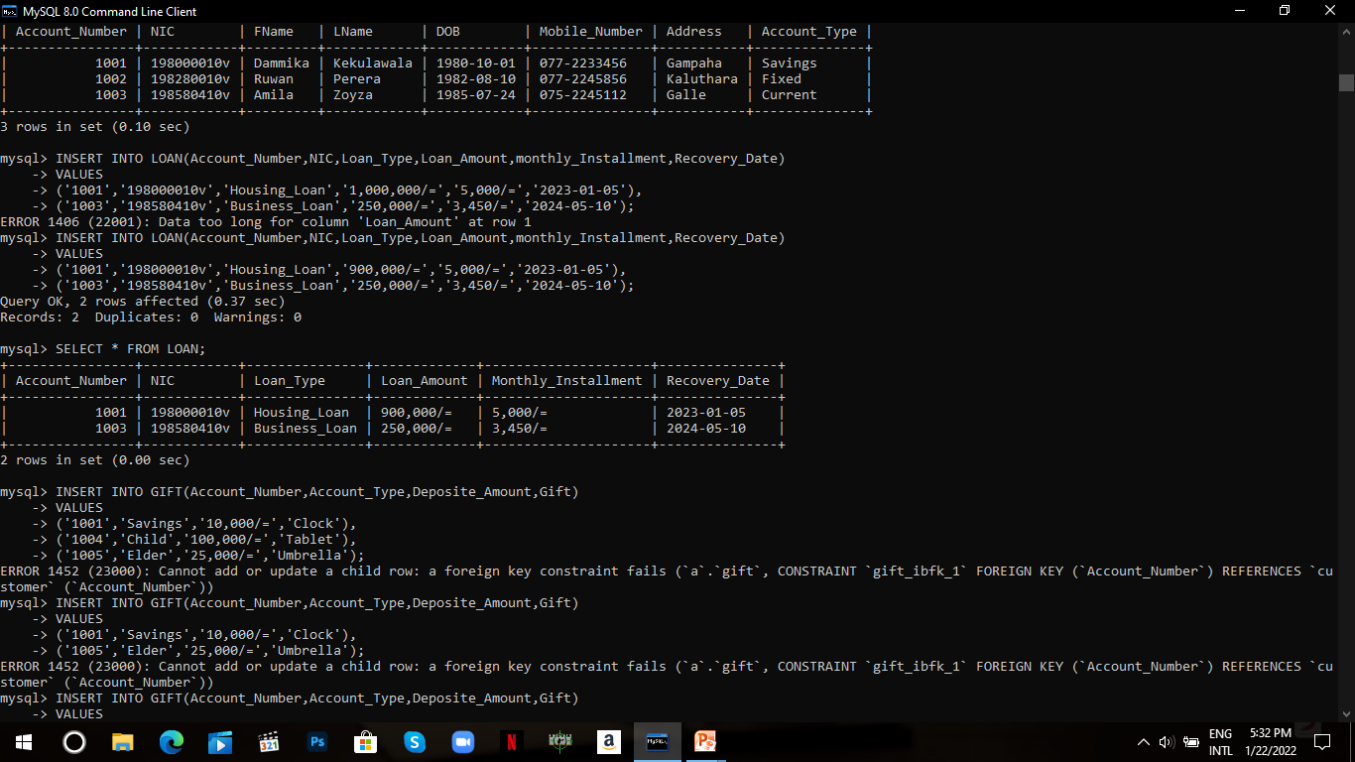

Slide 12
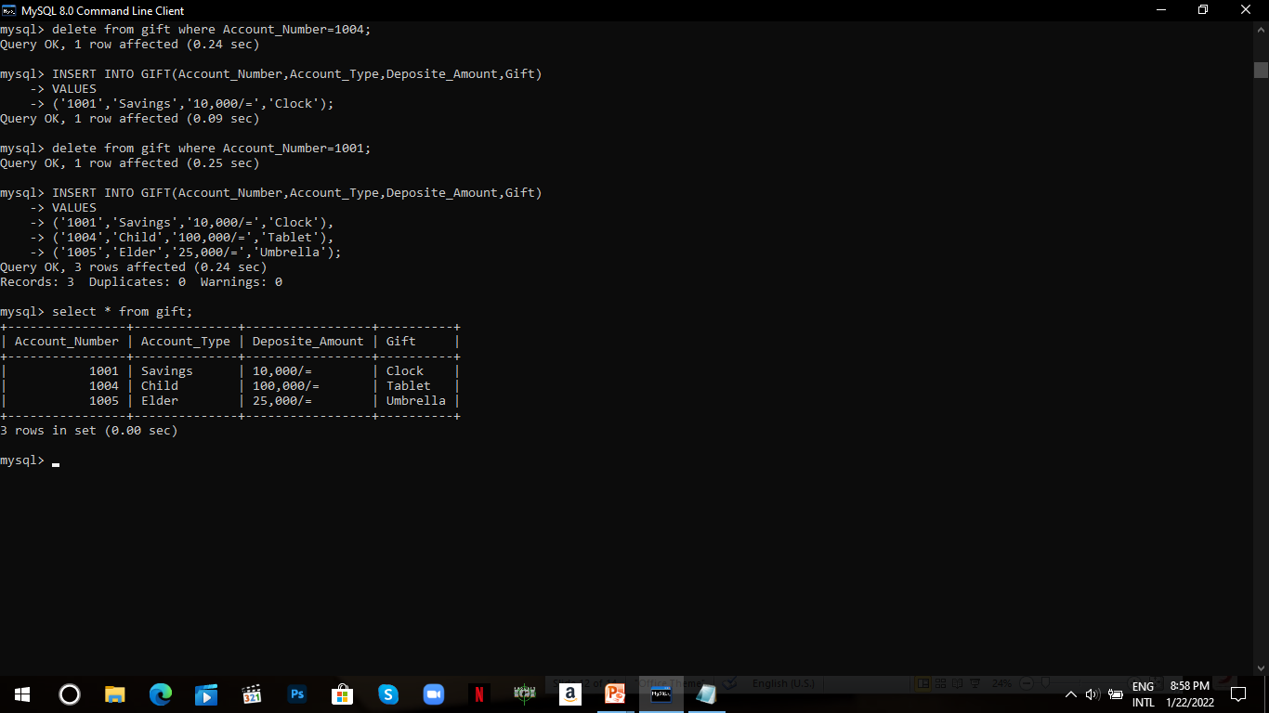
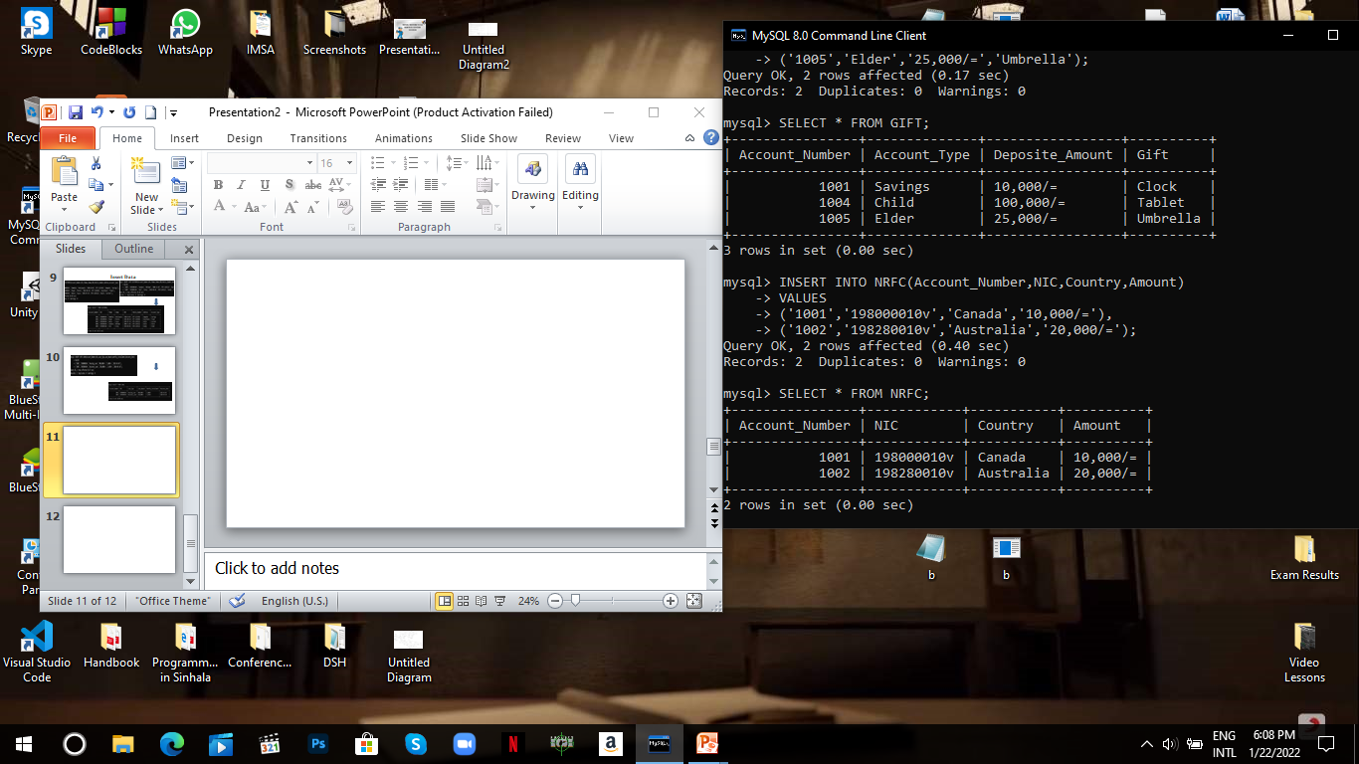

Slide 13
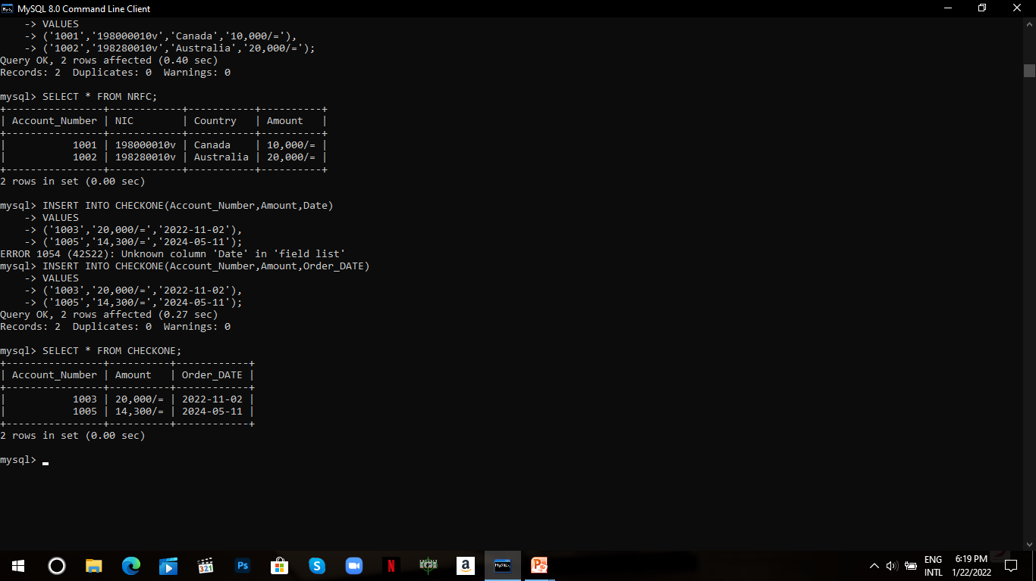
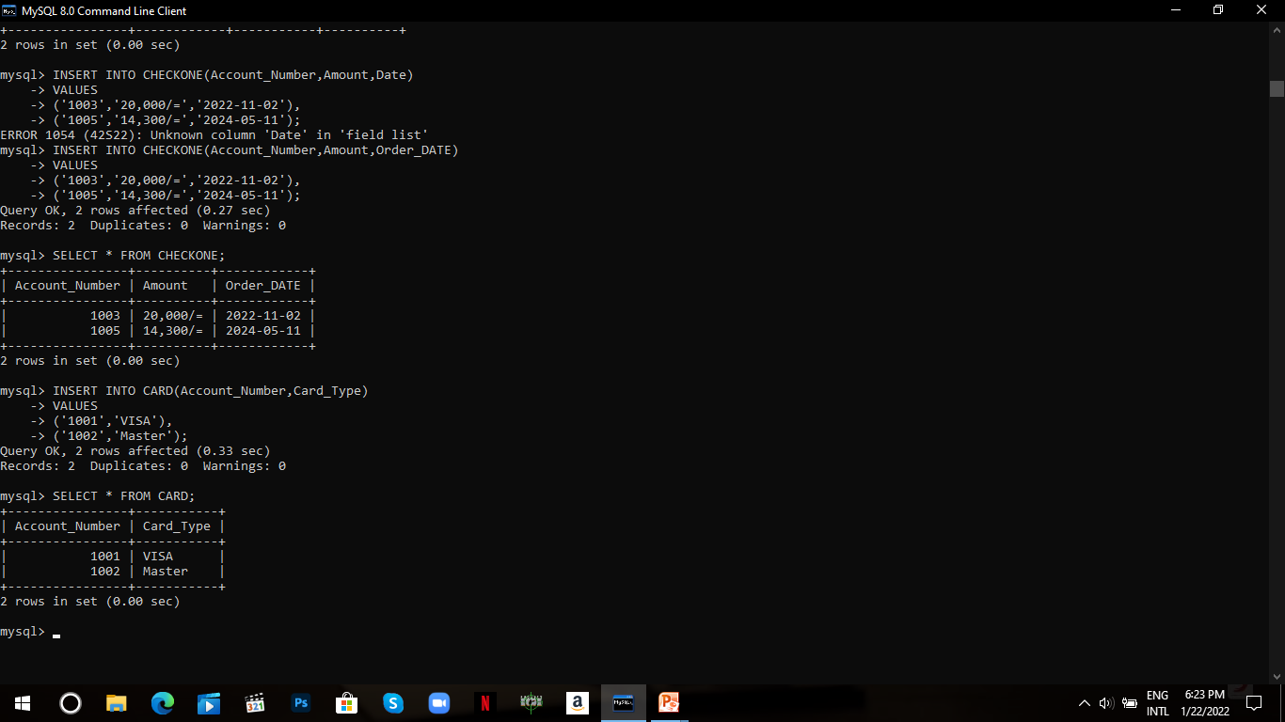

Slide 14
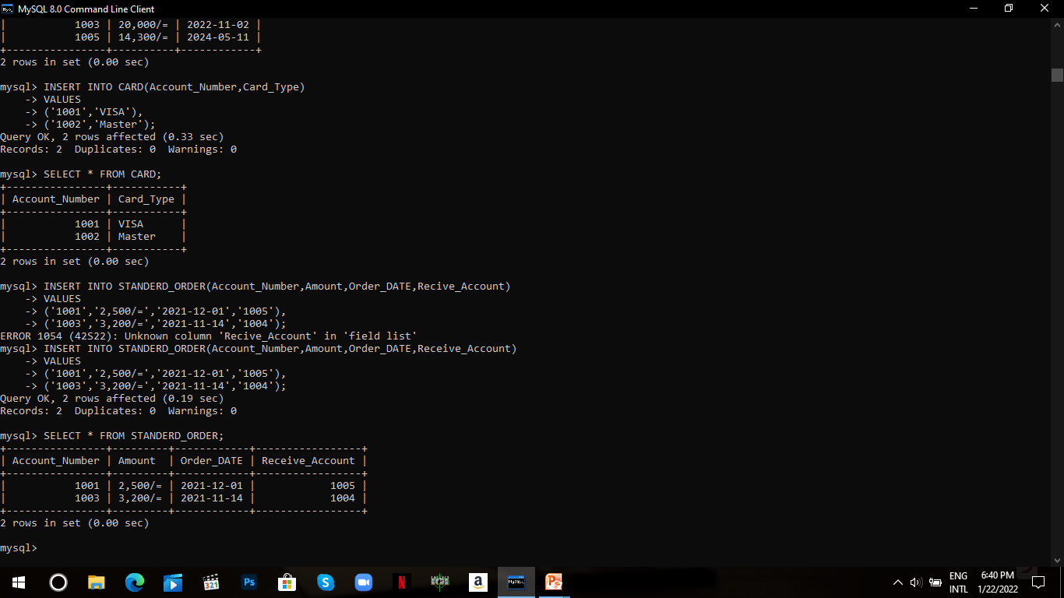
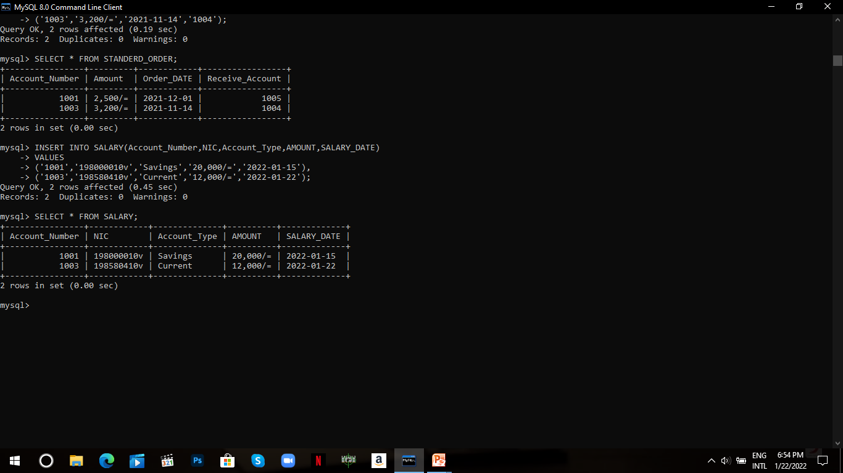

Slide 15
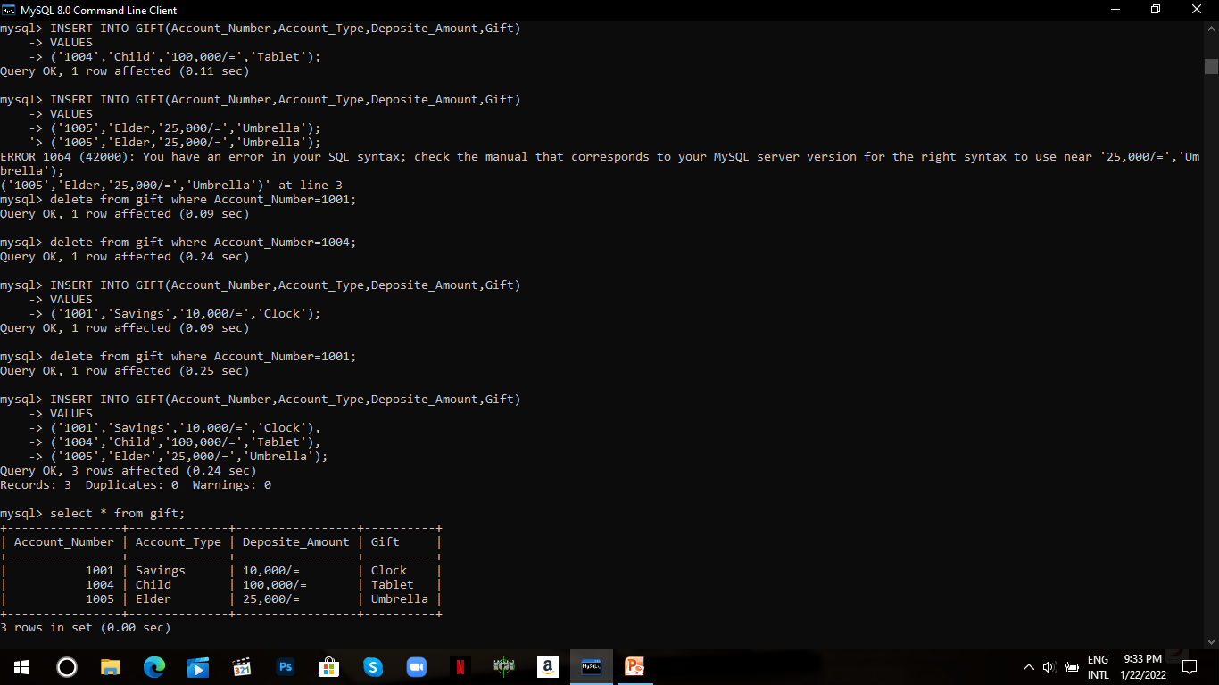
Delete Data

Slide 16
Thank You!

